Slide 1



INVITATION
We cordially invite you to honor your presence for the
NBJ Parish Cricket Tournament
4th Edition…
On Saturday 14th January 2023, 7.00 AM onwards @ KCR Cricket Grounds, Ghatupally, Maheshwaram.
Pls support, share and
https://youtube.com/@nbjparishsports
By
Organizing Committee

Slide 2
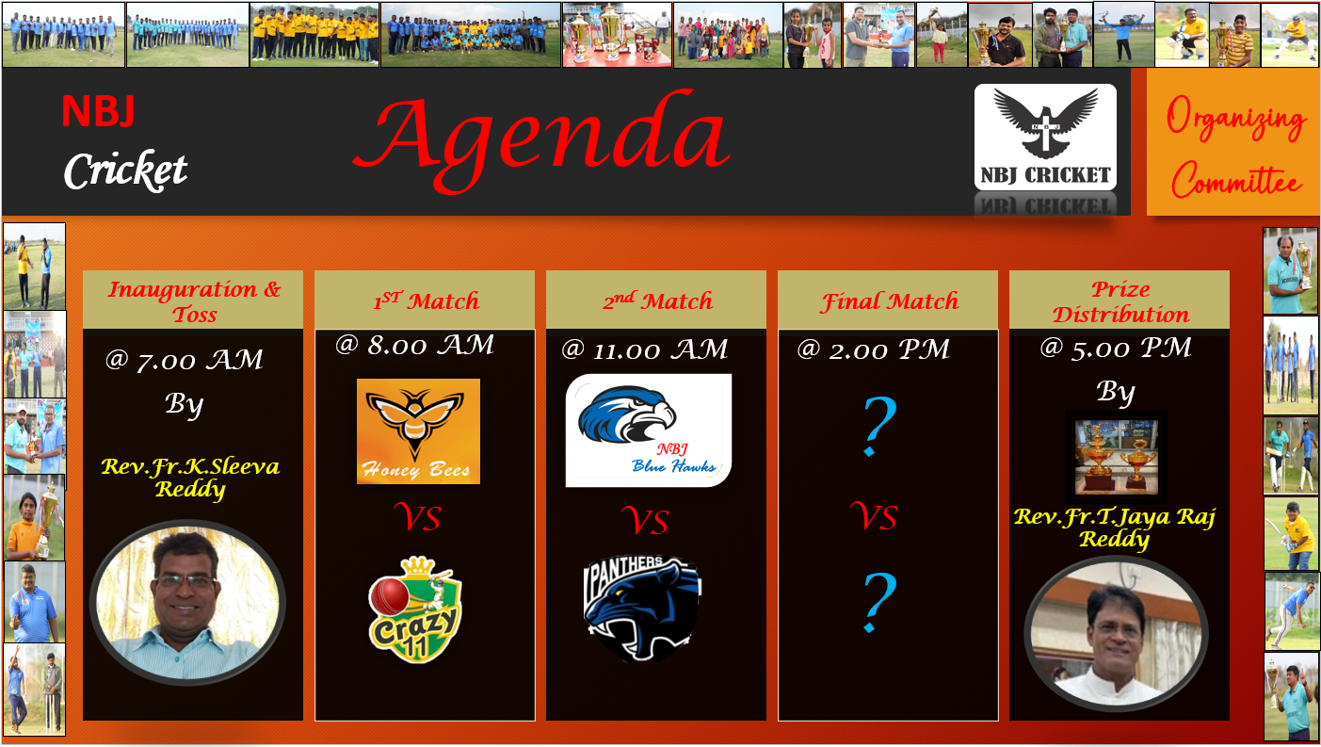
Thank you
Mirjam Nilsson​
mirjam@contoso.com
www.contoso.com

Slide 3
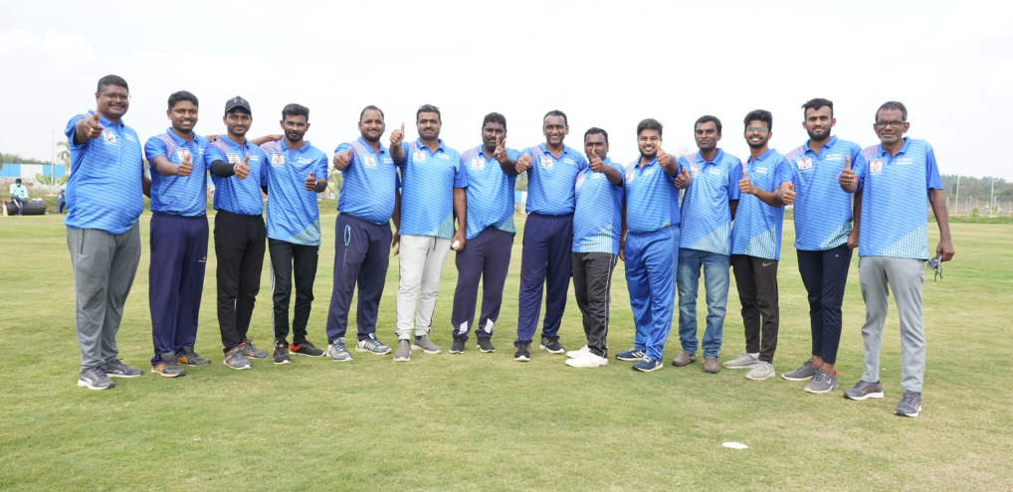
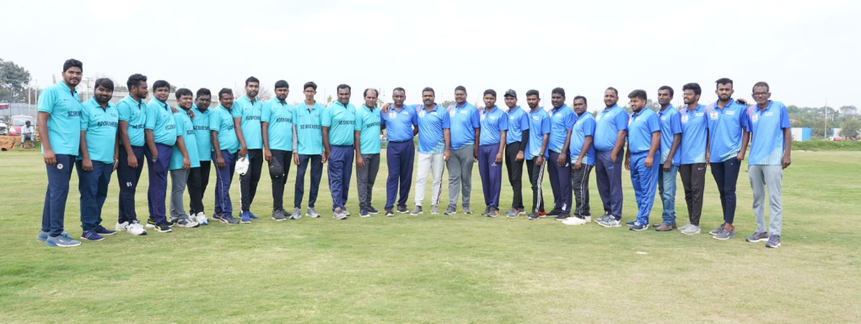
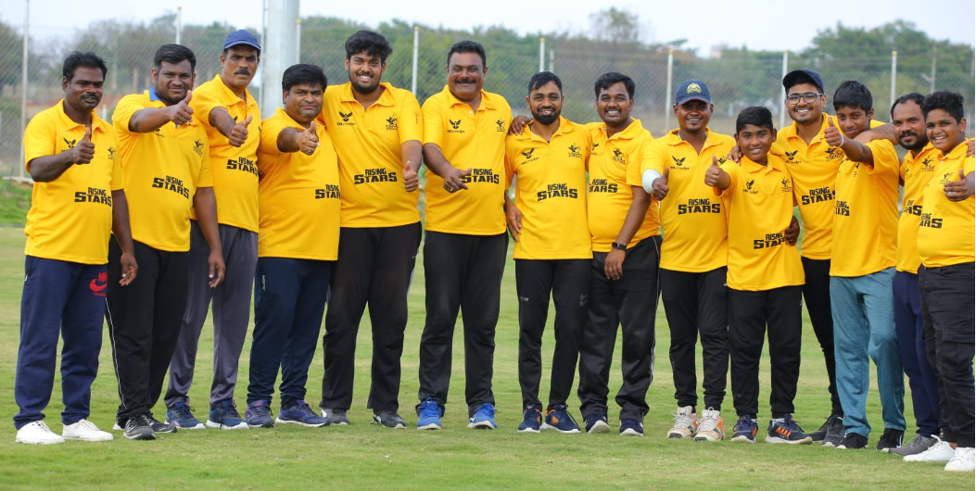
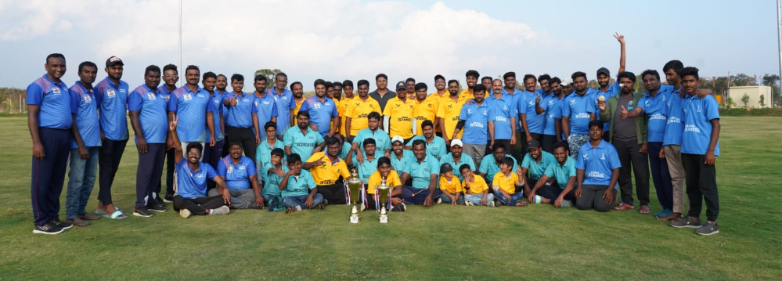
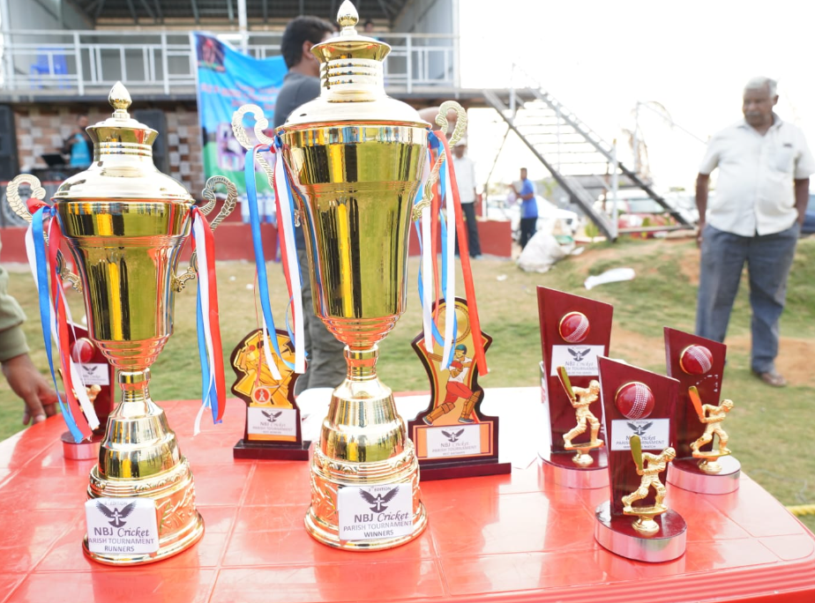
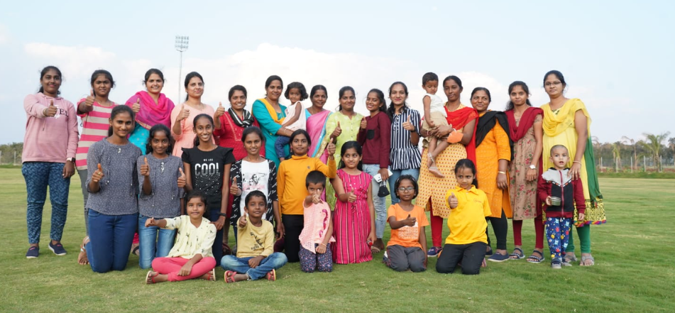
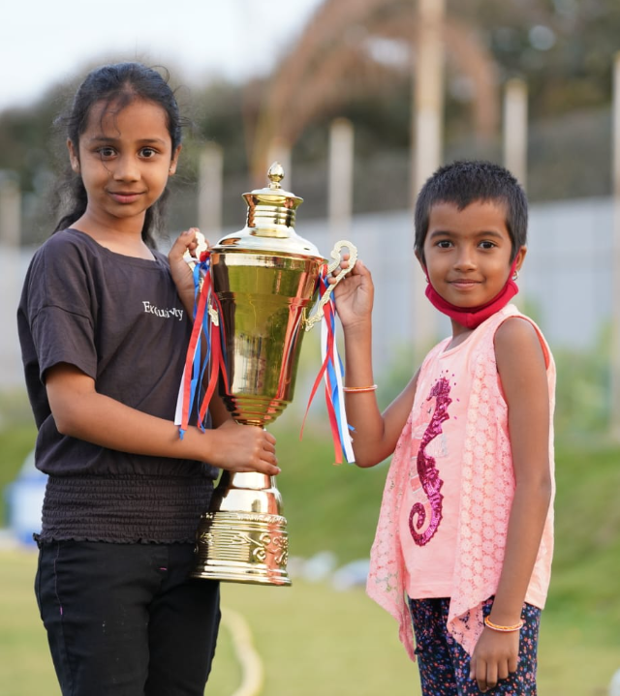
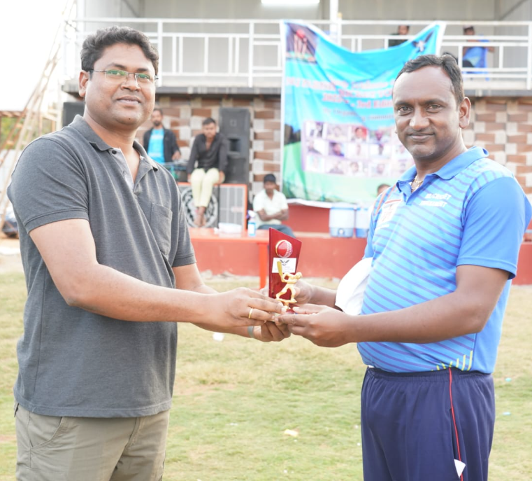
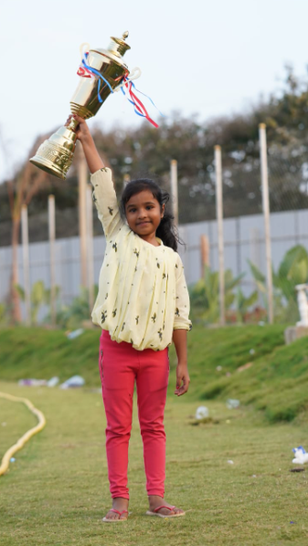
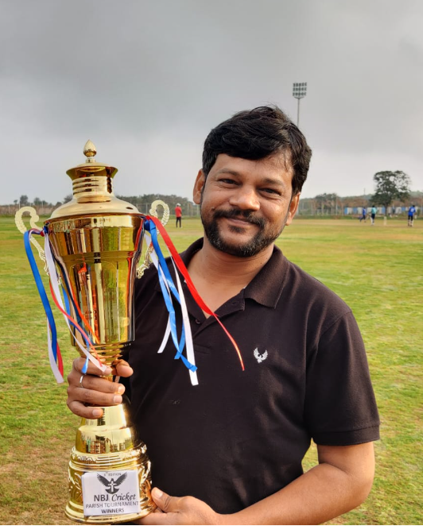
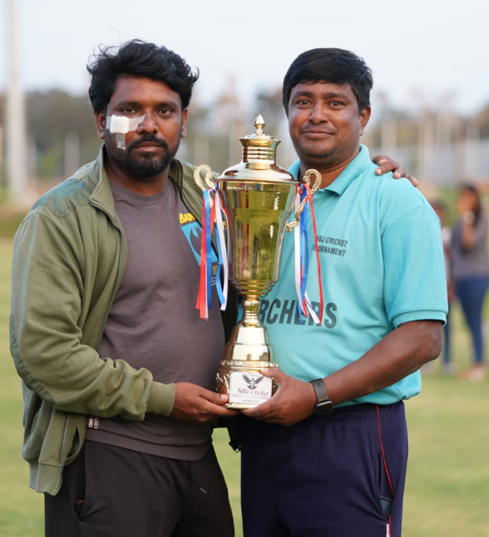
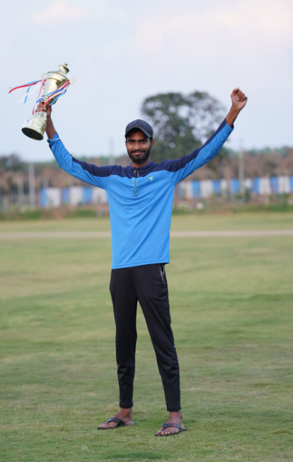
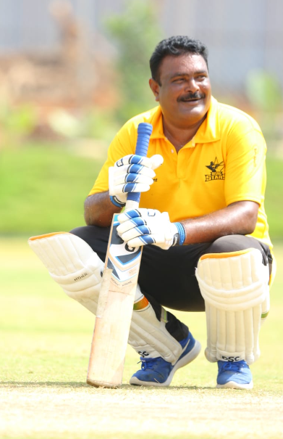
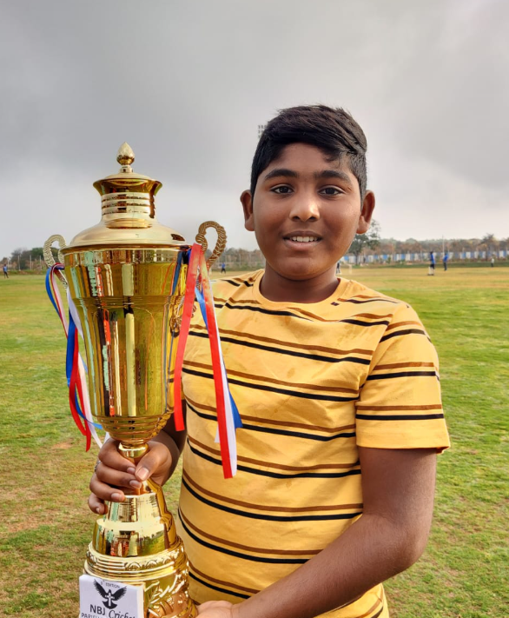
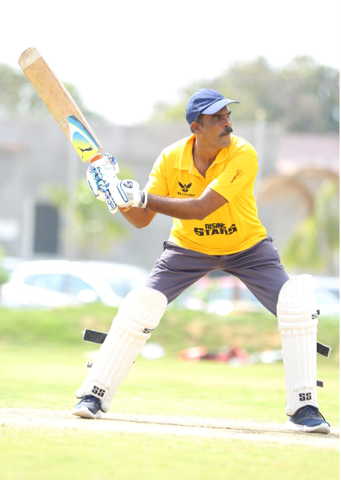

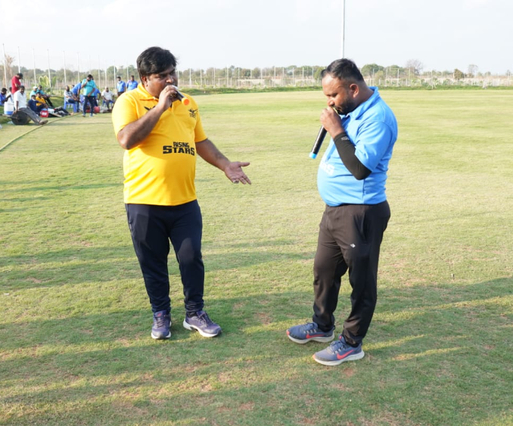
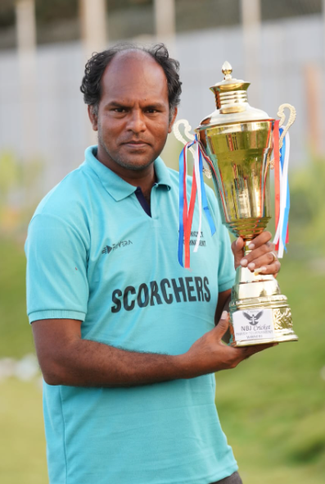
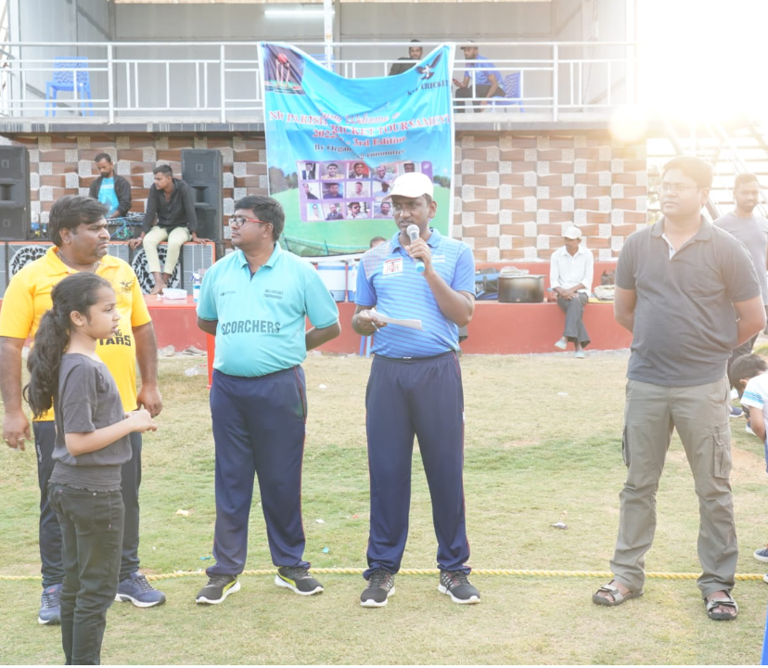
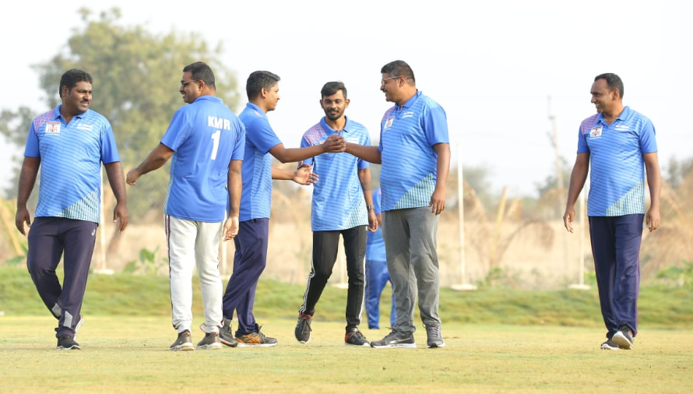


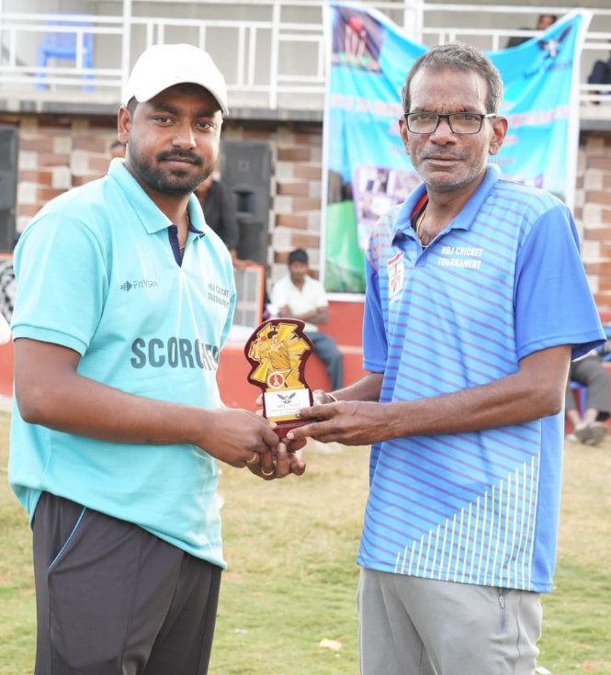
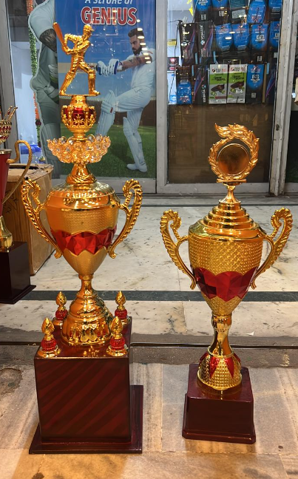
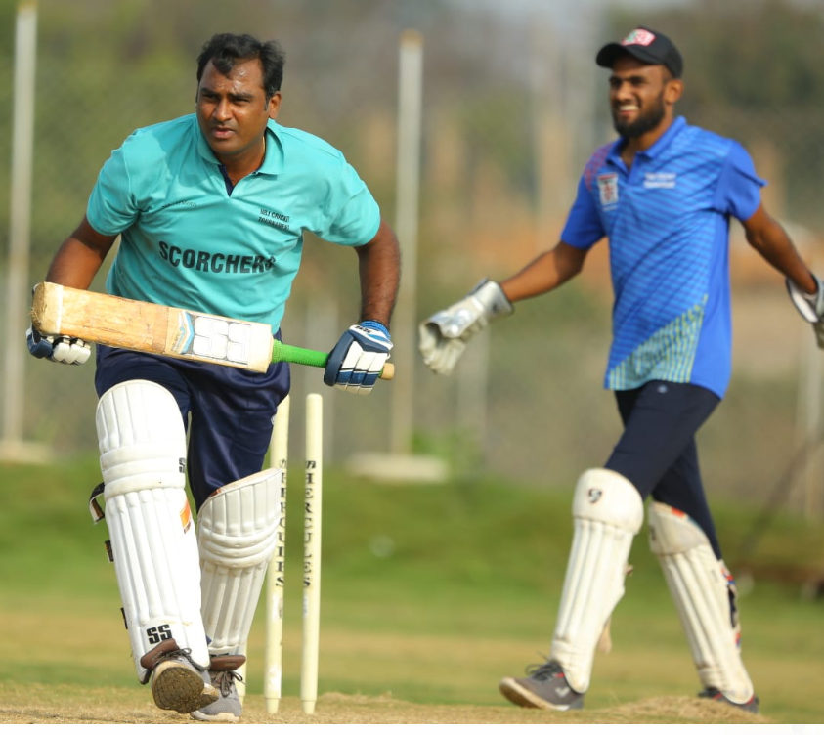
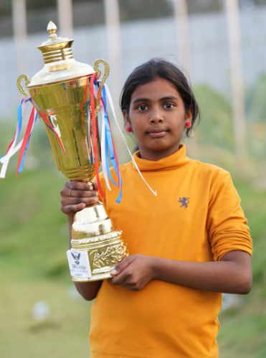
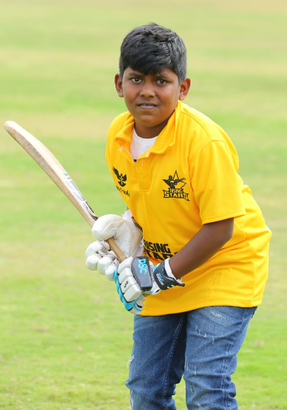
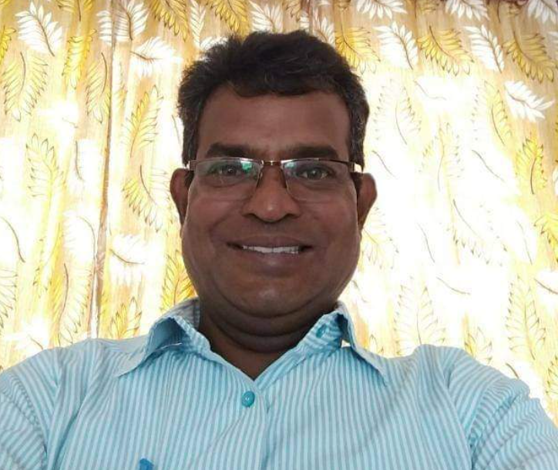
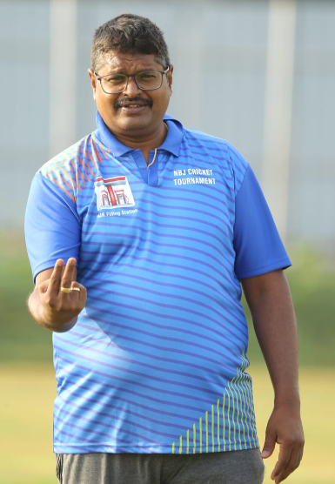


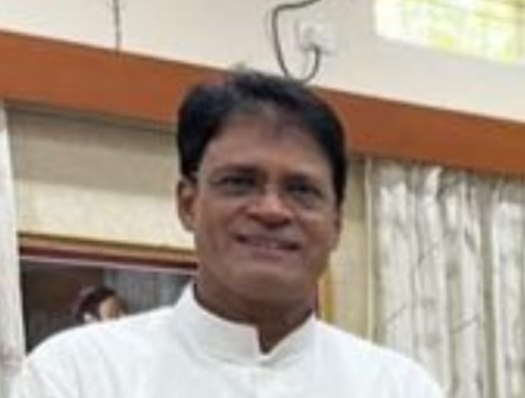
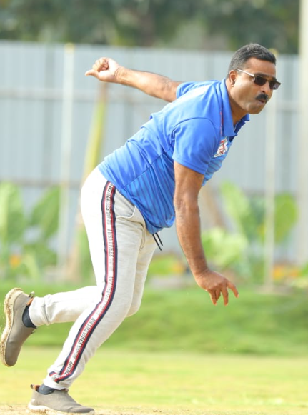
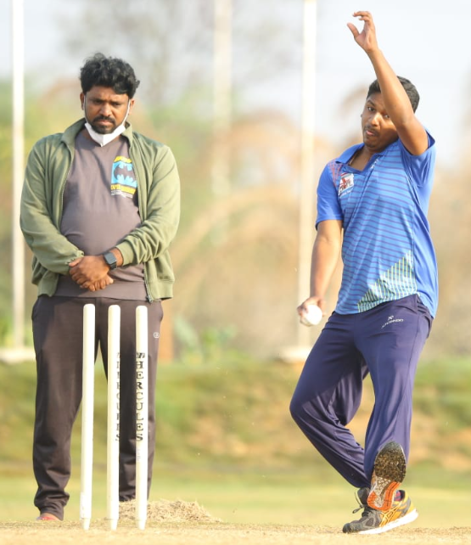
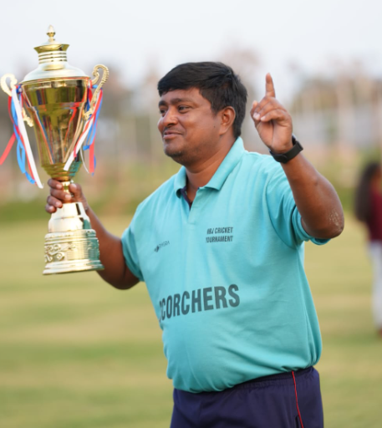
Agenda
Organizing Committee
Inauguration & Toss
1ST Match
2nd Match
Prize Distribution
Final Match
@ 8.00 AM
@ 11.00 AM
@ 2.00 PM
@ 5.00 PM
By
@ 7.00 AM
By
?
Rev.Fr.K.Sleeva Reddy
VS
VS
VS
Rev.Fr.T.Jaya Raj Reddy
?

Slide 4

Agenda
Inauguration and toss for the 1st Match By Rev.Fr.K.Sleeva Reddy @ 7.30 AM
First Match between Honey Bees Vs Crazy 11 @ 8.00 AM
Second Match between NBJ Blue Hawks Vs Panthers
Pls support, share and
https://youtube.com/@nbjparishsports

Slide 5

NBJ Parish Cricket Tournament
NBJ
Cricket
Umpires
Kranthi
1
Arun
Match Referee

